Slide 1
How Chinese speech-recognition errors degrade English translation
DRDO INTERNSHIP · PROJECT SUMMARY
A cascaded ASR to MT study with Whisper large-v3, Paraformer-zh and TowerInstruct-7B
[Intern name] · [Project guide] · 27 October 2026
Notes:
Placeholders in square brackets on this slide (intern name, guide) need to be filled in before presenting. This deck summarises the 26-page final report: problem, method, results, analysis, comparison with two reference papers, limits and next steps.

Slide 2
Problem statement
In a speech-translation cascade the translator never hears the audio. A wrongly recognised word is translated as if it had been said, and modern models translate it fluently and confidently.
RQ1
RQ2
RQ3
RQ4
How accurate are two Chinese ASR systems on the same speech?
How much BLEU, chrF++ and COMET is lost when translation gets ASR text?
Which kinds of recognition error cause the largest losses?
Does a sentence’s character error rate predict its translation loss?
Chinese ASR errors and English translation
02
Notes:
Background: speech translation is often built as two stages, ASR then MT. The weakness of the cascade is that errors made by the recogniser are passed on. The four research questions structure the rest of the talk: accuracy of recognition, size of the translation loss, which errors cause it, and whether CER predicts it. Scope: pilot study of 848 sentences, Chinese to English, synthetic speech.

Slide 3
Pipeline and method
1 · Datasets
2 · Speech
3 · Recognition
4 · Translation
CoVoST 2 and FLEURS give Chinese sentences with English references
Edge-TTS, four voices, turns each sentence into 16 kHz audio
Whisper large-v3 and Paraformer-zh transcribe the audio
TowerInstruct-7B translates; BLEU, chrF++ and COMET-22 score it
Every sentence is translated three times: from the correct text, from the Whisper transcript and from the Paraformer transcript.
The gap to the clean translation is the loss caused by ASR errors.
Chinese ASR errors and English translation
03
Notes:
Four steps follow the proposed methodology: datasets, text-to-speech, ASR, translation and evaluation. The ASR input is TTS audio generated from the Chinese text, so the correct transcript is known exactly. The clean condition (Tower applied to the correct text) is the upper bound: comparing against it separates damage done by ASR from errors the translation model would make anyway. Nothing was trained: only pre-trained models were used, run as notebooks on Kaggle GPUs.

Slide 4
Data and models
Data
Models and metrics
Corpus | Clips | Median length
CoVoST 2 | 500 | 4.2 s
FLEURS | 349 | 8.0 s
Built | 849 | 5.6 s
Evaluated | 848 | 5.6 s
Stage | Component
Speech | Edge-TTS, 4 voices
ASR | Whisper large-v3, Paraformer-zh
Translation | TowerInstruct-7B-v0.2
Metrics | CER, BLEU, chrF++, COMET-22
One defective TTS clip was excluded after an audio check.
Why not TowerChat? It was trained on English with German, French, Portuguese, Korean and Dutch, so it does not cover Chinese. TowerInstruct-7B, its base model, does.
Chinese ASR errors and English translation
04
Notes:
CoVoST 2 sentences are short Wikipedia phrases with many rare names; FLEURS sentences are longer and more ordinary. Common Voice itself is no longer on Hugging Face, so CoVoST 2 was loaded from a mirror with embedded audio and FLEURS was joined to its English sentences by id. Audio duration ranges from 0.2 to 20.7 s. TowerChat is the system from Pombal et al. 2025; the translation model choice was agreed with the project guide.

Slide 5
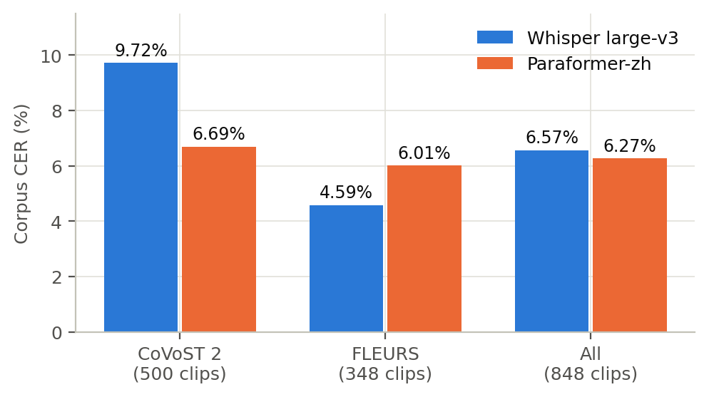
Recognition accuracy
6.57%
Whisper large-v3, character error rate
6.27%
Paraformer-zh, character error rate
Whisper is worse on CoVoST 2 (9.72% vs 6.69%) and better on FLEURS (4.59% vs 6.01%).
Chinese ASR errors and English translation
05
Notes:
Corpus character error rate on 848 clips: total edits divided by total reference characters, after converting traditional to simplified characters and removing punctuation. Both systems are close overall, but with different profiles: CoVoST 2 is full of rare Wikipedia names, which hurts Whisper more, while FLEURS has longer ordinary sentences. Paraformer is steadier across the two sources.

Slide 6
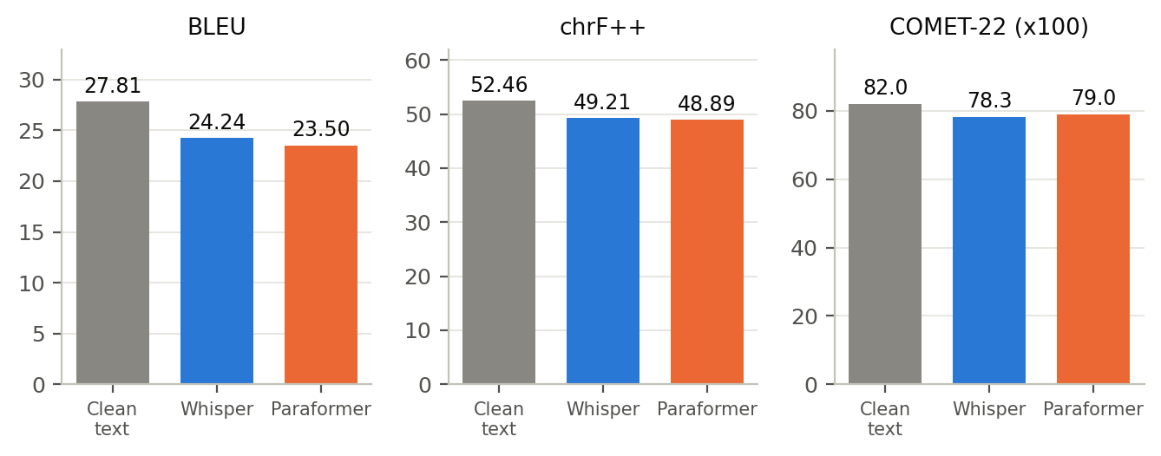
Translation quality
−3.6 to −4.3
BLEU lost to ASR errors
−3.3 to −3.6
chrF++ lost
−0.03 to −0.04
COMET-22 lost
Clean = Tower applied to the correct Chinese text. 848 clips.
Chinese ASR errors and English translation
06
Notes:
Scores against the English reference on 848 clips. Clean text: 27.81 BLEU, 52.46 chrF++, COMET 0.8195. Whisper input: 24.24, 49.21, 0.7827. Paraformer input: 23.50, 48.89, 0.7899. The ranges on the right are Whisper first, then Paraformer: BLEU loss 3.57 and 4.31, chrF++ loss 3.25 and 3.57, COMET loss 0.037 and 0.030. Paraformer has the lower CER and the smaller COMET loss but the larger BLEU loss, so CER alone does not rank ASR systems for translation.

Slide 7
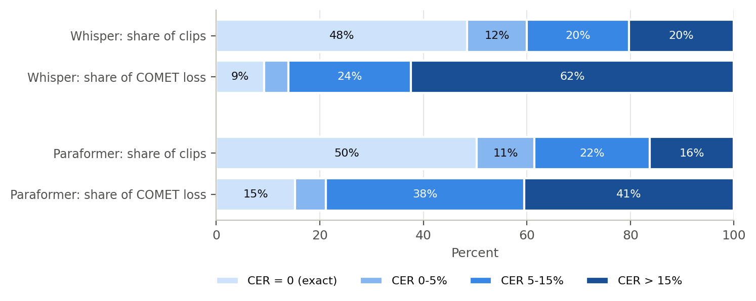
Source of the translation loss
62%
of Whisper’s COMET loss comes from the 20% of clips with CER above 15%
≈ 50%
of clips are transcribed exactly and lose almost nothing
Chinese ASR errors and English translation
07
Notes:
Clips are grouped by their own CER: exact, 0 to 5 percent, 5 to 15 percent and above 15 percent. The exact bucket holds 411 of 848 clips for Whisper and 427 for Paraformer, with a COMET loss of only 0.007 to 0.009. The loss rises steeply with CER: 0.015 to 0.016, 0.044 to 0.051, then 0.113 for Whisper and 0.074 for Paraformer above 15 percent. For Paraformer the worst bucket holds 16 percent of clips and about 41 percent of the loss. Shares of the loss are approximate, derived from bucket means. Takeaway: average scores hide a heavy tail; improving the worst fifth of transcripts would recover most of the lost quality.

Slide 8
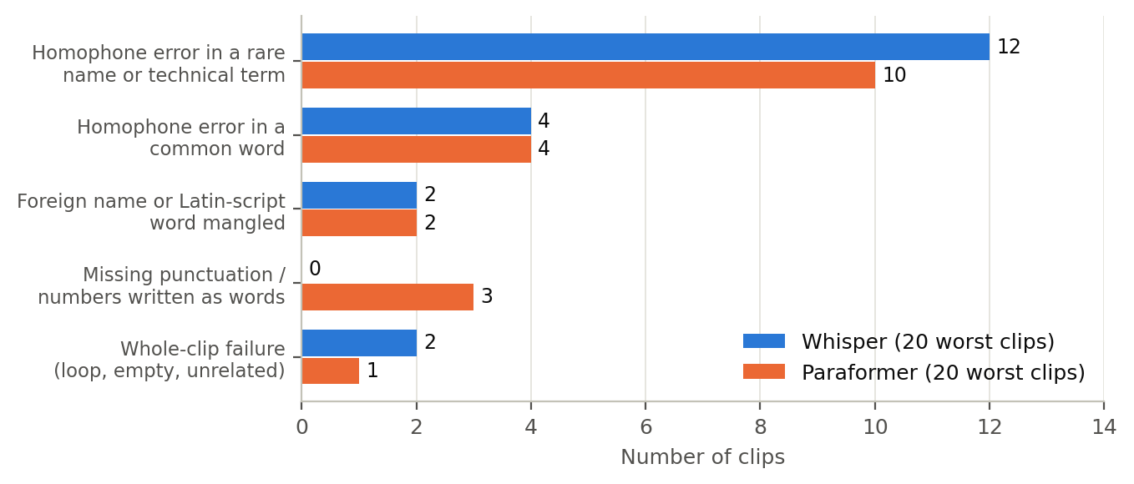
Error types in the worst cases
EXAMPLE · WHISPER
铂基 → 搏击
“Other platinum-based drugs include cisplatin and carboplatin.”
became “Other combat drugs include sinupret and kampfer.”
Primary error type in the 20 worst clips per system, classified by hand.
Chinese ASR errors and English translation
08
Notes:
The 40 sentences with the largest COMET loss were classified by hand: 22 are homophone errors in rare names or technical terms, 8 are homophone errors in common words, 4 are mangled foreign names, 3 come from missing punctuation or numbers written as words (all Paraformer), and 3 are whole-clip failures. This is about 5 percent of the data, so it shows what causes the large losses, not how common each type is overall. The classification was done by the author and not checked by a native speaker. Mandarin has many near-identical sounds, so an ASR system that does not know a rare word substitutes a likelier one, and the translator then translates the wrong word faithfully.

Slide 9
Quality checks
Defective audio
CER is incomplete
Repetition loops
One sentence of 55 characters was synthesised as 0.24 s of audio. It was the worst case for both ASR systems, so it was excluded. CER fell by 0.24 points.
Correlation with translation loss is only 0.50 for Whisper and 0.33 for Paraformer. A missing question mark gave CER 0.0 and still lost 0.31 COMET.
Whisper can repeat one name until the token limit, and Tower then translates the loop. Guards against repetition are a clear next step.
Chinese ASR errors and English translation
09
Notes:
An automatic audio check of all 849 clips found no clipping, no very quiet clips and nothing longer than Whisper’s 30 second window. It found one defective clip, fleurs_00121: Whisper returned an unrelated three-character string and Paraformer returned nothing, though neither model was at fault. After excluding it, every result was recomputed on 848 clips and the earlier CERs were reproduced exactly before the exclusion, so the comparison is like for like. The listening check was done informally by the author; individual ratings were not recorded.

Slide 10
Comparison with the reference papers
 | Pombal et al. (2025), TowerChat | Nieminen et al. (2025), retrieval-augmented MT
Focus | Context-aware training and quality-aware decoding for chat translation | Combining terminology and translation-memory matches in one MT system
Languages | English with German, French, Portuguese, Korean, Dutch; no Chinese | English to Finnish
Finding | Beats TowerInstruct; with quality-aware decoding it beats GPT-4o on WMT24 | Contrastive ensembling beats naive ensembles; Gemma 3 12B best on terms
For us | Context could repair wrong words; decoding costs about 100x generation | A glossary targets our main error: rare names and terms
Both papers study text input. Their COMET scores (about 92 to 93) are not comparable with ours: different data, languages and domains.
Chinese ASR errors and English translation
10
Notes:
Both papers improve the translation stage with information a plain model lacks: conversation context in Pombal et al., and retrieved terms and translation-memory matches in Nieminen et al. Our study measures what happens when the input to that stage is damaged by ASR, so they are complementary. Pombal et al. show that context helps most when translation without context is poor, which suggests surrounding sentences could make the right term more likely than a homophone; this is a hypothesis for future work, since we translated each sentence alone. Their quality-aware decoding samples 100 translations and picks one with a COMET criterion, which improved all metrics but needs about 100 times more generation. Nieminen et al. find that a large LLM is best at using supplied terminology, supporting a domain glossary. Both papers also build extra metrics because BLEU and COMET do not measure term or context accuracy, which matches our finding that a wrong name moves the scores only modestly.

Slide 11
Limitations and future scope
Limitations
Future scope
Synthetic speech from one cloud TTS engine
848 sentences, one run, no significance tests
One translation model, greedy decoding
Noisy CoVoST 2 references; error review of only 40 cases
Real recordings, noise, accents and a second offline TTS
Glossary biasing and repetition guards for ASR
Context-aware translation with terminology constraints
Confidence intervals, human evaluation and entity-accuracy metrics
Chinese ASR errors and English translation
11
Notes:
Main limits: the audio is clean synthetic speech, so real-world ASR errors will be higher and different in character; the sample is small and results are point estimates; the Tower models are licensed CC-BY-NC-4.0, which matters for deployment beyond research. Future work in order of value: evaluate on the original human recordings already stored in the manifest, add a domain glossary and term-aware decoding, test context-aware translation and quality-aware decoding, and add bootstrap confidence intervals plus a native-speaker review of the error taxonomy. An end-to-end speech-translation baseline is also worth comparing with the cascade.

Slide 12
Conclusion
ASR errors cost about 3.6 to 4.3 BLEU and 0.03 to 0.04 COMET.
Half of the sentences lose almost nothing; a tail of badly recognised ones carries most of the loss.
One wrong character in a rare name or term can reverse a translation.
Next: real audio, a domain glossary and context-aware translation.
Chinese ASR errors and English translation
12
Notes:
Close with the three findings, then the practical message: treat the result as a baseline and a method. It is a pilot on synthetic speech with one translation model, so it should be repeated on real audio and domain vocabulary before conclusions are drawn for deployment. The full report has the tables, the worked examples and the comparison with both papers.

